Slide 1

Spreadsheet Compression Via Sql

Slide 2
The goal
The goal of the project is to compress spreadsheets via sql.
Traditional spreadsheets such as csv and excel store data by each row
While this is ideal for most spreadsheets where very little blank space exists, csv wastes a lot of space on the computer storing essentially nothing
The goal of sql storage is to store individual cells in a database instead of entire rows and columns

Slide 3
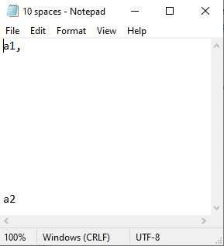


Slide 4
Origins
Saw a reddit post of an IT professional mocking the CFO because he ran out of storage space and didn’t know why
He stored all his information in Excel spreadsheets
Spreadsheets take up a ton of room in a computer
Even a blank Excel document takes up 9,394 bytes
I wanted to explore the option of storing individual cells instead of individual rows

Slide 5
How are cells stored
When a new file is saved, it is given an entry in file_id table with a path and id
Cells are then added to the cells table with their row column(A2, BD4, etc), file_id, content, and style flags (bold and italic)
This means that each cell is equal to
content.length * 4 + row_column.length*4 + 4 +style_flags.length(max 8) bytes

Slide 6
Best Case vs Worst Case
In the best case scenario, a document has lots of blank space.
Csv and Excel will spend lots of storage trying to store all the white space
To test this, we will have a document with one character at the beginning and one at the end
In the worst case scenario, the document has no or little white space
To test this, we will have a document with a single char, a blank line, a char, a blank line, etc
Kind of like a vertical checkerboard

Slide 7
Best Case (All Blanks)
raw csv |  |  | excel
empty | 0 |  | emtpy | 9,394
10 | 27 |  | 10 | 9,773
100 | 207 |  | 100 | 9,774
1,000 | 2007 |  | 1,000 | 9,774
10,000 | 20,007 |  | 10,000 | 9,780
Cloud Based Spreadsheet (msg = 16 bytes)
empty | <numCharsInPath>*4 + 4
10 | 8+4*3+16 + empty = 36 + empty
100 | 4*4 + 8 + 16 = 40
1,000 | 8 + 5*4 + 16 = 44
10,000 | 8 + 5*5 + 16 = 48

Slide 8
Worst Case (Checkered)
raw csv |  |  | excel
10 | 26 |  | 10 | 9,793
100 | 251 |  | 100 | 10,086
1,000 | 2,508 |  | 1,000 | 12,842
10,000 | 25,046 |  | 10,000 | 39,816
empty | <numCharsInPath>*4 + 4 | with changes
10 | 332 | 72
100 | 3212 | 612
1,000 | 40012 | 6012
10,000 | 480012 | 60012

Slide 9
Demo

Slide 10
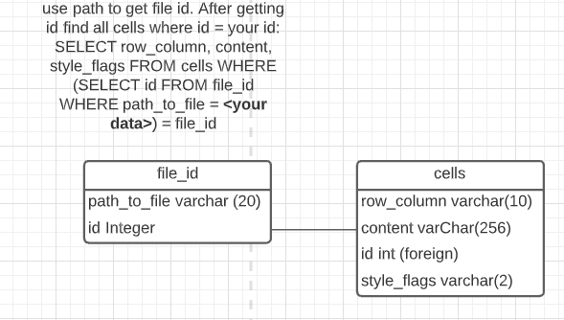
Database

Slide 11

Where database is lacking
One critical error in the database caused data to take up much more space than it needed to: row_column
I thought it would be easier to work with
A better implementation would be to store row and column as integer values then convert them to row_column server side
Another alternative is to store all cells for a document in one table. And when given the path, only look at that table
Cuts the need for “file_id” table and for id column in “cells”
But now you need to deal with the overhead that creating a table brings

Slide 12
Downsides
Only good for certain files
Where there is no white space, this compression is terrible
Very slow to save and open data
Must search all cells for all files to find your files cells
This could be fixed by creating tables with table name = file name
Security
Doesn’t cut down on reusable objects

Slide 13



Positives
Excellent for certain types of files
Lots of non-concurrent white space
Availability
files can be stored in the cloud and accessed by anyone
Security
Can be implemented on a local sql server so intellectual property is never sent over the internet
Your company knows where to data is being stored

Slide 14
Conclusion
Sql based compression is great for small spreadsheets with lots of white space
Csv is great for general purpose documents
Excel is best for large spreadsheets with multiple concurrent blank space

